Slide 1
Proposed Zoning Amendments
Special Town Meeting November 13, 2024
Warrant Review - October 29, 2024
Anne Capra, Director of Planning and Conservation
acapra@southhadleyma.gov
(413) 538-5030 x 6128

Slide 2
Article 9: Amendments 255-31 Flexible Development &
255 Attachment 1 Use Regulations Schedule
Article 10: NEW Bylaw -- 255-XX Common Drive
Article 11: NEW Bylaw -- 255-YY Common Open Space
Article 12: Amendments 255-47 Multifamily and Multiple Dwellings
Planning Board Report to Town Meeting:
https://www.southhadley.org/1318/ProposedDraft-Bylaws

Slide 3
Comprehensive Amendments
Revise Flexible Development Bylaw
Eliminate confusion with Subdivision Regulations and encourage use.
Create uniformity throughout Zoning Bylaw on common open space requirements – NEW Common Open Space Bylaw
Create NEW Common Driveway Bylaw and Regulations (design standards) – for non-subdivisions, i.e. multiple dwellings on a single parcel

Slide 4
What is the Flexible Development Bylaw?
ARTICLE 9
Chapter 255-31
Zoning tool – regulates the use of the land
Creates a residential development with protected open space.
Adopted in 2004 to replace a Cluster Development Bylaw
Has only been used 3 times in 19 years:
Skinner Woods, Amherst Road
Mountainbrook Subdivision, Red Bridge Lane and Lyon Green
Dry Brook Village, Hadley Street – withdrawn, never built
Bylaw has not been effective at protecting open space and creating new housing units

Slide 5
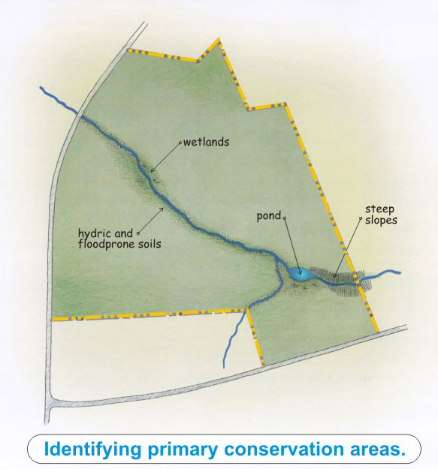
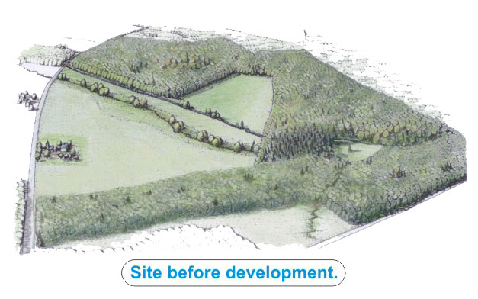
What is Flexible Development?
1
Graphics: Arendt, Randall, 1996. Conservation Design for Subdivisions, Washington, D.C.

Slide 6
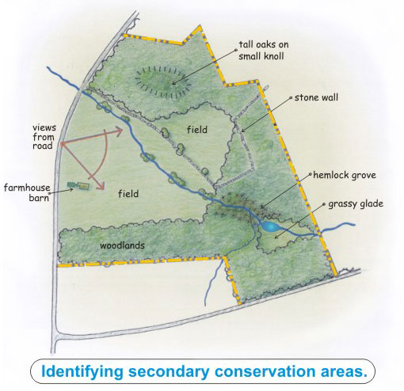
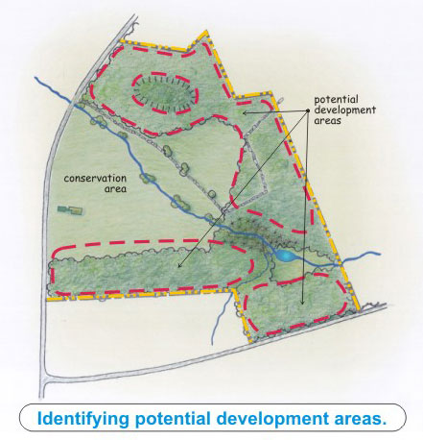
2
3
Graphics: Arendt, Randall, 1996. Conservation Design for Subdivisions, Washington, D.C.

Slide 7
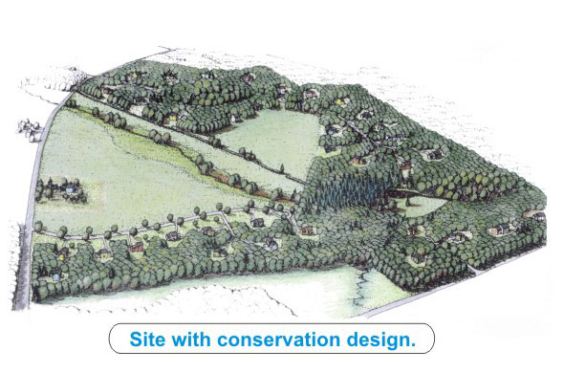
Final Flexible Development Layout

Slide 8
255-31 Flexible Development
Purposes
ADD: Local food production and climate resilience
Applicability
Change from Special Permit to Site Plan Review (Special Permit within
the Water Supply Protection District)
Definitive subdivision plan or common drive approval
C. Definitions
“Usable Open Space” changed to “Common Open Space”; and, added
“as well as land for conservation purposes” to definition.

Slide 9
D. Design Process
(f) Definitive plan – DELETE and REPLACE:
Final steps in design process
If subdivision of land resulting in separate lots with new roadway (anticipated to be accepted by as a Town road) – require Definitive Subdivision Plan approval.
If multiple dwellings on a single parcel (no subdivision of land) and drive is not intended to be accepted by the Town/remain private – require Common Drive approval.

Slide 10
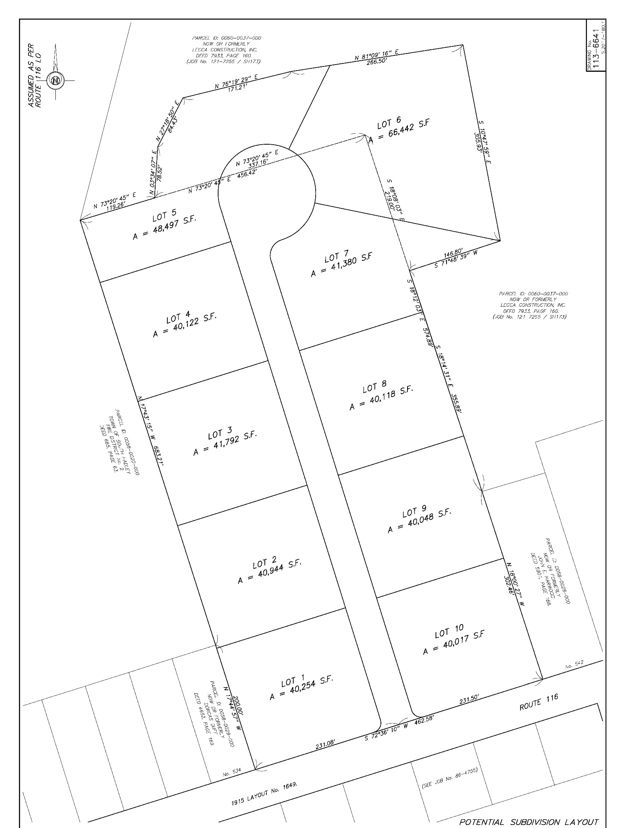
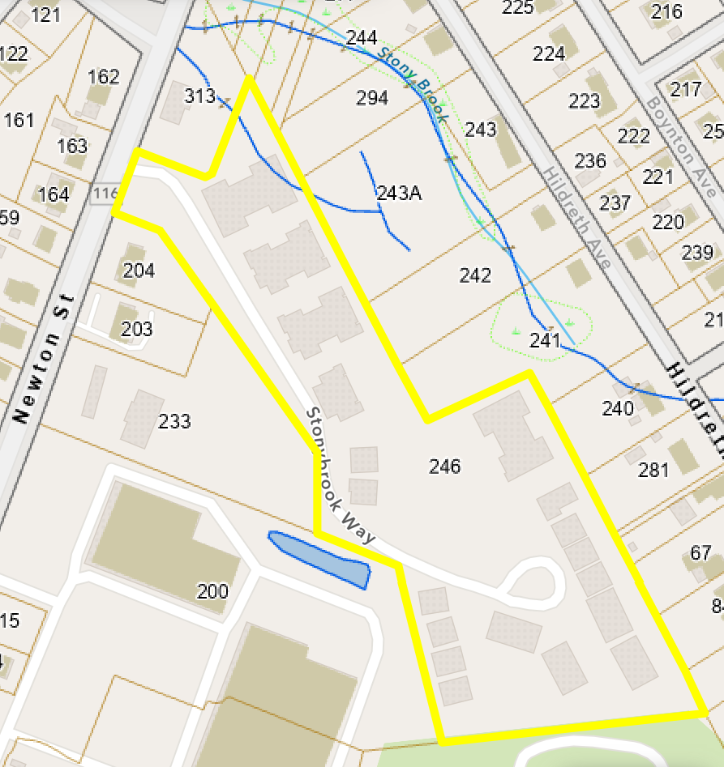
Typical Subdivision Layout
Common Drive Layout
New road and multiple new parcels.
Multiple dwellings on a single parcel with shared driveway.
Notes:
Flexible Development Bylaw -Flexible development is a unique approach in that it permits wide flexibility in defining the dimensional standards and density allowed for the residential development with a focus on open space and cultural space preservation.

Slide 11
E. Procedures
Eliminate Special Permit, Site Plan Review only, unless within the Water Supply Protection District
DELETE (1) Concept Review
DELETE (2) Subdivision plan
ADD Definitive Plan or Common Drive Submission
Definitive Plan – For subdivision of land that will result in creation of new roadway.
Common Drive – NO subdivision of land
Needs to comply with NEW Common Drive Regulations

Slide 12
F. Housing Types Permitted
F. (1) thru (9) - DELETE and REPLACE
ADD
F. Establishment of Flexible Development Tiers
Tier 1: 30-50% open space
Tier 2: >50% open space

Slide 13
G. Housing Types Permitted - ADD
Tier | Open Space (% total site) | Housing Types Permitted | Density Standards
Tier 1 | 30-50% | Detached Single Family (new) Attached Single Family Two Family (Duplex) | Existing Preset Method
 |  |  | Zoning District Agricultural Residence A-1 Residence A-2 Residence B | # units/acre 0.75 or 0.90(WSPD) 1.125 or 1.35* 1.20 1.8 2.00 3.0 3.25 4.8
 |  |  | Multiply # units/acre in existing Preset by 2
Tier 2 | >50% | Detached Single Family (new) Attached Single Family Two Family (Duplex) Three Family (Triplex) | Zoning District | # units/acre
 |  |  | Agricultural Residence A-1 Residence A-2 | 0.75 x2 = 1.50 0.90(WSPD) x2 = 1.80 1.20 x2 = 2.4 2.00 x2 = 4.0
 |  |  | Residence B | 3.25 x2 = 6.5
*If property within Water Supply Protection District and lacks public water and sewer, lower density figure applies.

Slide 14
H. Dimensional Standards
1. Reduce minimum tract size from 5 acres to 3 acres.

Slide 15
J. Density Bonuses
Additional open space. DELETE and REPLACE Small Dwelling Units
“Dwelling units (detached , attached or part of a multifamily building) < or equal to 800 SF of conditioned floor area shall count as 0.5 units.”
Affordable housing units. DELETE and REPLACE
“Dwelling units qualifying as affordable shall count as 0.25 units.”
5. Total dwelling unit count. The total dwelling unit count with density bonuses may round up to the nearest whole number.
*Density Bonuses cap at 50% of base unit count*

Slide 16
L. Common Open Space (previously K.)
DELETE and REPLACE
(1) All Flexible Developments must include Common Open Space which conforms to the provisions of 255-96 of the Zoning Bylaw.
This is the proposed NEW Common Open Space Bylaw.

Slide 17
M. Ownership of Common Open Space
(previously L.)
DELETE and REPLACE
The Common Open Space required under Section 255-31K shall be permanently restricted for use as open space and not permitted to be developed into additional residential buildings, commercial uses, or other improvements except as permitted in accordance with the provisions of Section 255-96.
Ownership of the required Common Open Space shall conform to the provisions of 255-96 of the Zoning Bylaw.
255-96 is the proposed NEW Common Open Space Bylaw.

Slide 18
255 Attachment 1 Use Regulations Schedule Proposed Amendments
Use Classification – Residential Uses | Zoning Districts
 | Residence |  |  |  | AGR | Business |  |  |  | Industrial |  |  | Water Supply Protection Overlay
 | A-1 | A-2 | B | C |  | A1 | A | B | C | A | B | Garden
Flexible residential developments, as provided in Article VII | SP SPR | SP SPR | SP SPR | SP SPR | SP SPR | N | N | N | N | N | N | N | SP

Slide 19
NEW 255-XX Common Drive
ARTICLE 10
Applicable to multifamily developments and developments with more than 1 building for dwelling purposes on single parcel
Planning Board to adopt Rules and Regulations for design, construction and maintenance of Common Drive.
Common Drive plans to be approved by Planning Board.
Common Drives are NOT:
Existing public ways
Subdivision roads
Preexisting ways prior to adoption of Subdivision Control Law (c.1954)

Slide 20
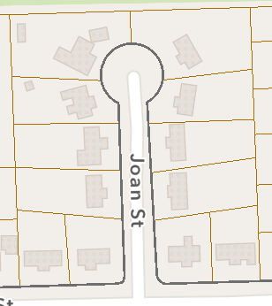
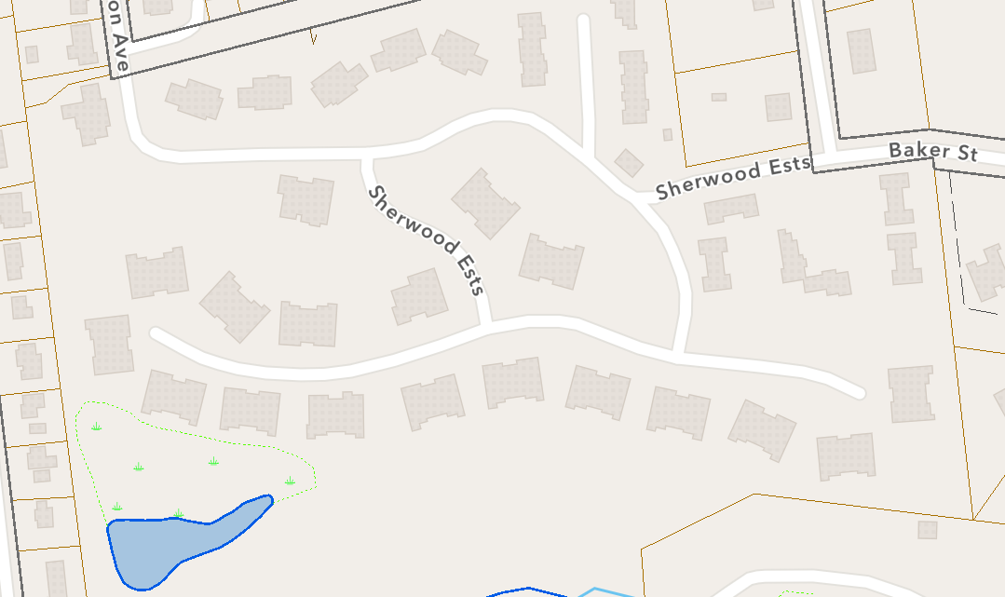
Land fronting Common Drives not eligible for ANR.
Statement of adequate way.
Maintenance Plan to be recorded at Hamshire County Registry of Deeds.
Financial Performance Guarantee may be required.
I. Form of performance guranatee.
Subdivision Road Layout
Common Drive

Slide 21
NEW 255-YY Common Open Space
ARTICLE 11
Applies to all Zoning Bylaws that require open space set aside:
Multifamily developments
Flexible Development
A. Definition – “areas suitable for use as facilities and sites for play, tot lots, gardens, hiking/jogging trails or similar facilities, as well as land for conservation purposes.”
A. (1-7) Characteristics and dimensions for common open space.

Slide 22
A. (1-7) Characteristics and dimensions for common open space:
30% minimum required
Contiguous open space preferred (within development)
May be comprised of multiple parcels but no one parcel may be less thatn 25% of the common open space
Uses – agriculture, nature education, recreation, conservation, historic preservation, parks or combination thereof
Dwellings shall abut open space, and other access in the form of sidewalks or paths shall be provided
Less than 5% of the open space may have accessory structures

Slide 23
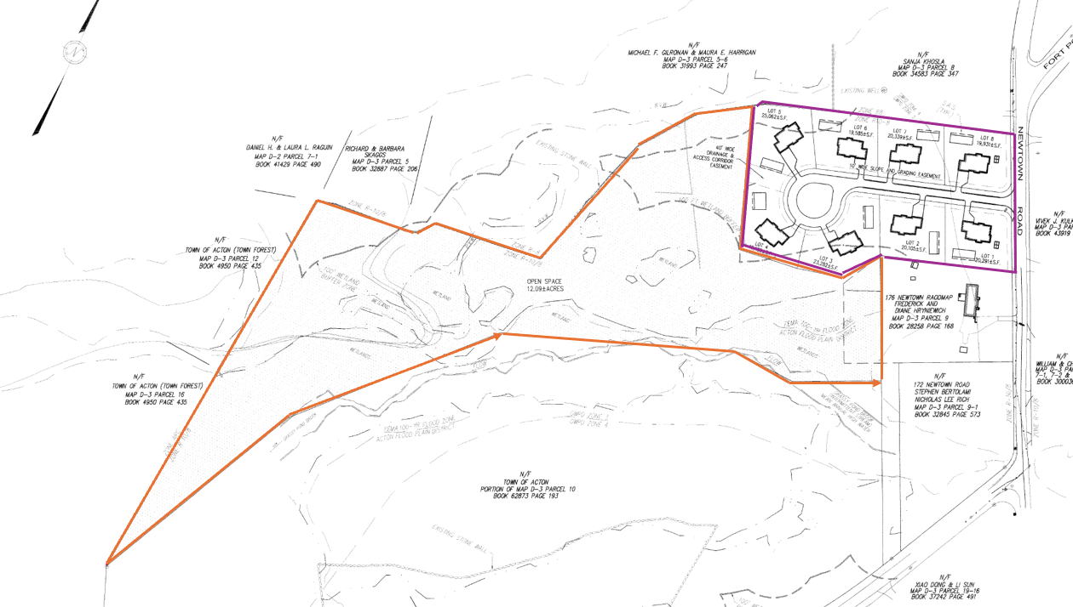
B. Ownership of Common Open Space
Conveyance:
Town of Conservation Commission
Conservation Non-Profit
Homeowners Trust or Corporation
Private entity under a Conservation Restriction
Restriction:
Must be in perpetuity (forever)
Preserved for uses stated above
Maintained for stated uses
Subdivision prohibited
Must include “springing rights” for perpetual restriction.
Common Open Space
Example Flexible Development Subdivision

Slide 24
255-47 Multifamily and Multiple Dwellings
ARTICLE 12
B. Entrances
ADD: Front entrances shall not open directly onto parking lots but rather sidewalks, streets or common open spaces.
DELETE: “Rear entrances and entrances for services and delivery may be from parking areas.”
D. Required Open space.
Delete
ADD G. Common Drive
Required compliance with 255-95 Common Drive and associated Rules and Regulations (new bylaw)

